Slide 1
Team 48
Andrew
David Firrinicieli, Eric Limeback, Ashwin Spencer, Andrew Taylor
Real Estate Listing Price Prediction Enhanced with Income Tax Data

Slide 2
Table of Contents
Andrew
Problem and Approach Overview
Process and Key Findings
Conclusions and Next Steps

Slide 3
Problem and Approach Overview
Andrew

Slide 4
Context & Problem Statement
Andrew
CONTEXT
Predicting house price information is not a new problem, but current approaches often don’t consider the affluency of the location of the house
How might knowing various tax return fields by zip code, such as adjusted gross income, help predict the prices of homes for a given time period?
PROBLEM STATEMENT
We aim to improve list price prediction models that use traditional features about the home (house size, number of bedrooms, number of bathrooms, etc.) by exploring and testing the addition of income-tax related zip code features.
LITERATURE SURVEY
Existing attempts to incorporate zip code or location primarily focus on directly encoding the spatial data, but don’t account for affluency or income tax features

Slide 5
Research Questions & Modeling Objective
Andrew
Our goal was to answer the below research questions.
Primary Research Question
How well can we predict house prices using both standard “listing” information about the house and income tax information about the residents of a zip code?
Secondary Research Questions
How does the performance of models with income tax data added compare to those with only house features?
Which income tax features are statistically significant? What is their relationship to house price?
Which traditional features are statistically significant? What is their relationship to house price? How does the set of significant features change when income tax features are added?

Slide 6
Methodology
Andrew
The team followed the four-step approach below to develop our models and answer the key question.
Data Cleansing & Transformation
Exploratory Data Analysis
Model Development & Selection
Results Evaluation
Create the dataset to feed EDA and the model
Summarize and explore before modeling
Test and select the best model
Interpret models to answer key questions
Perform null and duplicate checks
Confirm data types
Aggregate data as-needed
Join the real estate and income tax datasets and checking join veracity
Create calculated fields for our variables as needed
Develop univariate summaries (histograms, boxplots)
Understand dependent-independent variable summaries (pair plots, correlation heatmaps)
Correlation analysis
Split data into training/testing
Preprocess data (scaling, PCA)
Select and engineer features as-needed
Train and score models from different families
Select a ‘best’ model type, and fit that model on the final data
Evaluate model performance metrics to validate results and understand the predictive power of our model
Compare models with and without income tax data
Develop conclusions

Slide 7
Process & Key Findings
Andrew

Slide 8
Data Cleansing and Transformation
Eric
First, we completed data extraction, cleaning, and merging, including handling complexities around null values (details on following slide)
Steps Taken
Field | Description
price | Sale price of the house ($)
bed | Number of bedrooms on the listing
bath | Number of bathrooms on the listing
house | Binary flag representing whether a house or not (e.g. condo)
house.acre.lot | Lot size – evaluates to 0 for non-homes without lots
house_size | Size of the house, in sq ft
state | State
total_credit_amt | Total tax credits amount per return
taxable_income_amt | Taxable income amount per return
mortgageint_amt | Mortgage interest paid amount per return
p_mortgageint_nr | Proportion of returns with mortgage interest paid
inctax_amt | Income tax amount per return
p_unemploy_nr | Proportion of returns with unemployment
agi_amt | Adjust gross income (AGI) [2]
num_dependents | Number of dependents per return
p_re_taxes_nr | Number of returns with real estate taxes
Downloaded and explored data
Understood column meanings and selected initial feature list from income tax data
Filtered to time window
Removed duplicate rows from real estate data
Corrected zip code field
Aggregated income tax data
Joined the real estate and income tax datasets
Cleansed nulls and created interaction terms
Sources
USA Real Estate Dataset - https://www.kaggle.com/datasets/ahmedshahriarsakib/usa-real-estate-dataset?resource=download
Individual Income Tax Statistics - https://www.kaggle.com/datasets/irs/individual-income-tax-statistics

Slide 9
Handling Nulls
Eric
To Do
Eric - Provide missing stat on slide 9 to Andrew via Teams
Andrew – update visuals once Eric sends
During the cleansing process, a number of nulls were observed in the real estate data fields, and the below actions were taken.
Imputed nulls where information was available
Removed records with remaining nulls
In the `acre_lot` field, we assigned a value of 0 to all records representing apartments or condos
Note: We used regex to identify listings which included key words such as ‘apt’ and ‘unit’
In the `bed` field, we assigned a value of 0 to all records representing studio apartments (had 1 bath)
Field | Number of Nulls
house_size | 2,204 (29%)
address | 234 (3%)
acre_lot | 87 (1.2%)
bed | 25 (0.3%)
bath | 15 (0.2%)
1,600 (21%) Records
apartments / condos with no lot and imputed value for `acre_lot`
XXXX (Y%) Records
studio apartments with imputed value for `bed`
2,565 (34%) Records
Removed

Slide 10
Exploratory Data Analysis
Ashwin
Next, we completed EDA for the dataset, evaluating individual features and the response as well as the relationships between data fields.
Performed univariate analysis to explore distributions, observing and flagging any outliers for further action during modeling and analysis
Investigated feature/DV relationships using pairplots and correlation, forming hypotheses about which features would provide the most value to the model
Evaluated multicollinearity between predictors using a correlation heatmap, identifying whether or not mitigations measures will need to be taken

Slide 11
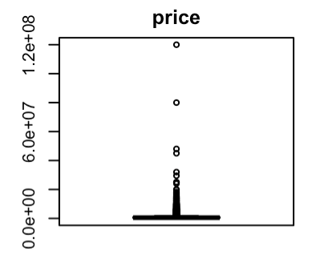
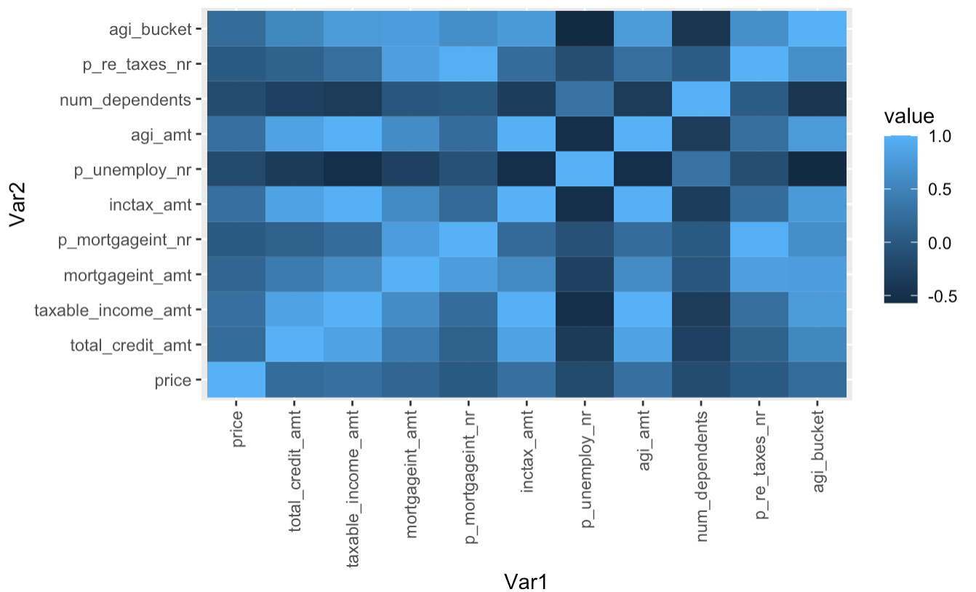
Observations and Initial Hypotheses
Ashwin
To Do
Ashwin – Perform EDA with real estate data and push notebook back to the cloud
Andrew – update visuals once Ashwin pushes update
During EDA, a few notable observations surfaced, along with initial hypotheses.
Feature | Correlation with Price
total_credit_amt | 0.215
taxable_income_amt | 0.292
mortgageint_amt | 0.174
p_mortgageint_nr | 0.020
inctax_amt | 0.292
p_unemploy_nr | -0.176
agi_amt | 0.288
num_dependents | -0.144
p_re_taxes_nr | 0.032
agi_bucket | 0.219
Univariate analysis revealed outliers in the price field which we will further investigate
Investigation of correlation between price and income tax features reveals limited linear signal
Evaluation of multicollinearity showed correlation between predictors, particularly in the income tax dataset
INITIAL HYPOTHESES
Real estate features are expected to provide the most signal to the model
Tax features related to affluency have the most potential to provide signal to the model
Tree-based models will likely far outperform linear models

Slide 12
Model Development & Selection
David
During model development and selection, we outlined the model types to evaluate, prepared the data, and evaluated each model, including hyperparameter search and preprocessing as needed
Identify Model Types
Data Prep
Evaluate Models
Linear Regression for baseline point of comparison and coefficient transparency
LASSO Regression for feature insights
Random Forest for tree-based model benefits
XGBoost for tree-based benefits and comparison to RF
Set seed and read in packages
Read in data and remove unnecessary columns
Make dummy variables out of the State names
Scale all non-binary numeric columns
Split into training and test sets (80/20 split)
Perform PCA (linear regression only)
Build model using all features on training data
Build model using only real estate features on training data
Evaluate R², RMSE, and MAE on test data

Slide 13
Model Performance Results
David
In evaluating the model strength, we’re able to come up with a few insights around the model types and the features.
MODEL STRENGTH
INSIGHTS
 | R-SQUARED
 | Real Estate Features | All Features
Linear Regression | 0.3408 | 0.3938
LASSO Regression | 0.3336 | 0.3939
Random Forest | 0.3450 | 0.5702
XGBoost | 0.2282 | 0.3073
Random Forest provides the most predictive model on both sets of features, and will be used to draw conclusions
For all model types, including income tax features adds between 0.05 and 0.23 to the R-squared (a significant amount!)
Our best model has an R-Squared of 0.57, which makes it moderately strong

Slide 14
Feature Insights
David
More specifically, we can use the results of the LASSO model to see which features were selected in a regularized model.
Field | LASSO Coefficient
(Intercept) | 777652.34
bed | .
bath | 736419.1
house | -53034
house.acre.lot | .
state_Connecticut | .
state_Delaware | .
state_Maine | .
state_Massachusetts | .
state_New.Hampshire | .
state_New.Jersey | .
state_New.York | 472845.74
state_Pennsylvania | .
state_Rhode.Island | .
state_Vermont | .
house_size | 231909.44
n1_total | 28145.47
total_credit_amt | .
taxable_income_amt | .
mortgageint_amt | .
p_mortgageint_nr | .
inctax_amt | 334825.93
p_unemploy_nr | .
agi_amt | .
num_dependents | -226096.28
p_re_taxes_nr | -61115.92
agi_bucket | .
INSIGHTS
The number of baths was selected, while beds was not
A listing that’s a house is ~$50k lower than one that is not, if all else is constant
A listing that’s in New York is ~$472k higher than one that is not, if all else is constant
The income tax amount and total number of returns in a zip code both have a positive relationship with price
The number of dependents and proportion of returns with real estate taxes both have a negative relationship with price

Slide 15
Conclusions

Slide 16
Conclusions
The models we developed help us answer our research questions.
Primary Research Question
Using a random forest model, we can achieve an R-squared value of ~0.57, which is a moderately effective model for a fairly behavioral response such as house price
Secondary Research Questions
Adding income tax features to the model improve the model, and increase the R-Squared value by 0.05-0.23
The most significant real estate features appear to be the size of the house, number of baths, and whether the house is in NY or MA
The most significant income tax features appear to be the number of returns, total tax credit amount, number of dependents, and the proportion of returns with real estate tax

Slide 17
Potential Improvements
If we were to look beyond this project, further improvements could be made to the model.
Enhance the data
Added data to the dataset (more zip code)
Add temporal features
Add more detailed real estate features
Improve the LASSO model by adding interaction terms

Slide 18
Literature Citations
[1] “Machine Learning based Predicting House Prices using Regression Techniques”; J Manasa, Radha Guota, N S Narahari; https://ieeexplore.ieee.org/abstract/document/9074952
[2] “Predicting House Prices with Spatial Dependence: A Comparison of Alternative Methods”; Steven Bourassa, Eva Cantoni, & Martin Hoesli; https://www.tandfonline.com/doi/abs/10.1080/10835547.2010.12091276

